Slide 1
EVENT MANAGEMENT AND TICKETING PLATFORM
DATABASE SYSTEMS ENGINEERING AND DISTRIBUTED BACKEND DEVELOPMENT - 25CS1302E
PRESENTED BY:
GEETHIKA CHOWDARY 250030354
V SIRI CHANDANA 2520030609

Slide 2
ABSTRACT
The Event Management & Ticketing Platform is a web-based application designed to simplify event organization and online ticket booking. The platform allows event organizers to create, manage, and promote events, while users can search for events, view event details, select tickets, make online payments, and receive digital tickets.
The main problem is that traditional event management often involves manual registration, paper-based tickets, inefficient record keeping, and difficulty in tracking ticket availability and attendees. These methods can be time-consuming, cause errors, and make it difficult for both organizers and users to manage bookings efficiently.
The proposed solution is a centralized digital platform that automates the complete event and ticketing process. It provides online event creation and management, event searching and filtering, ticket booking, secure payment processing, automatic e-ticket generation with QR codes, booking history, notifications, and attendee management. Admin and organizer dashboards can also be used to monitor events, bookings, users, and revenue.

Slide 3
PROBLEM STATEMENT
Traditional event management and ticket booking systems often depend on manual registration, paper-based tickets, and inefficient record keeping. Organizers may face difficulties in managing events, tracking ticket availability, handling attendees, and maintaining booking records. Users may also experience problems while searching for events, booking tickets, making payments, and receiving tickets. Therefore, there is a need for a centralized digital platform that makes event management and ticket booking faster, easier, and more efficient.

Slide 4
EXISTING SYSTEM
Manual event registration and ticket booking.
Paper-based tickets are commonly used.
Difficult to track ticket availability.
Manual maintenance of attendee and booking records.
Higher chances of errors and duplicate bookings.
Limited event search and filtering options.
PROPOSED SYSTEM
Online event creation and management.
Digital ticket booking and e-ticket generation.
QR-code-based tickets for easy verification.
Real-time ticket availability tracking.
Event search and filtering functionality.
Secure online payment using Razorpay / Stripe.

Slide 5
SOFTWARE TOOLS
Frontend: React.js, HTML, CSS, JavaScript
Backend: Node.js, Express.js
Database: MongoDB
Authentication: JWT (JSON Web Token)
Payment Gateway: Razorpay / Stripe
Ticket Generation: QR Code
Development Tools: Visual Studio Code, Git, GitHub
API Testing: Postman

Slide 6
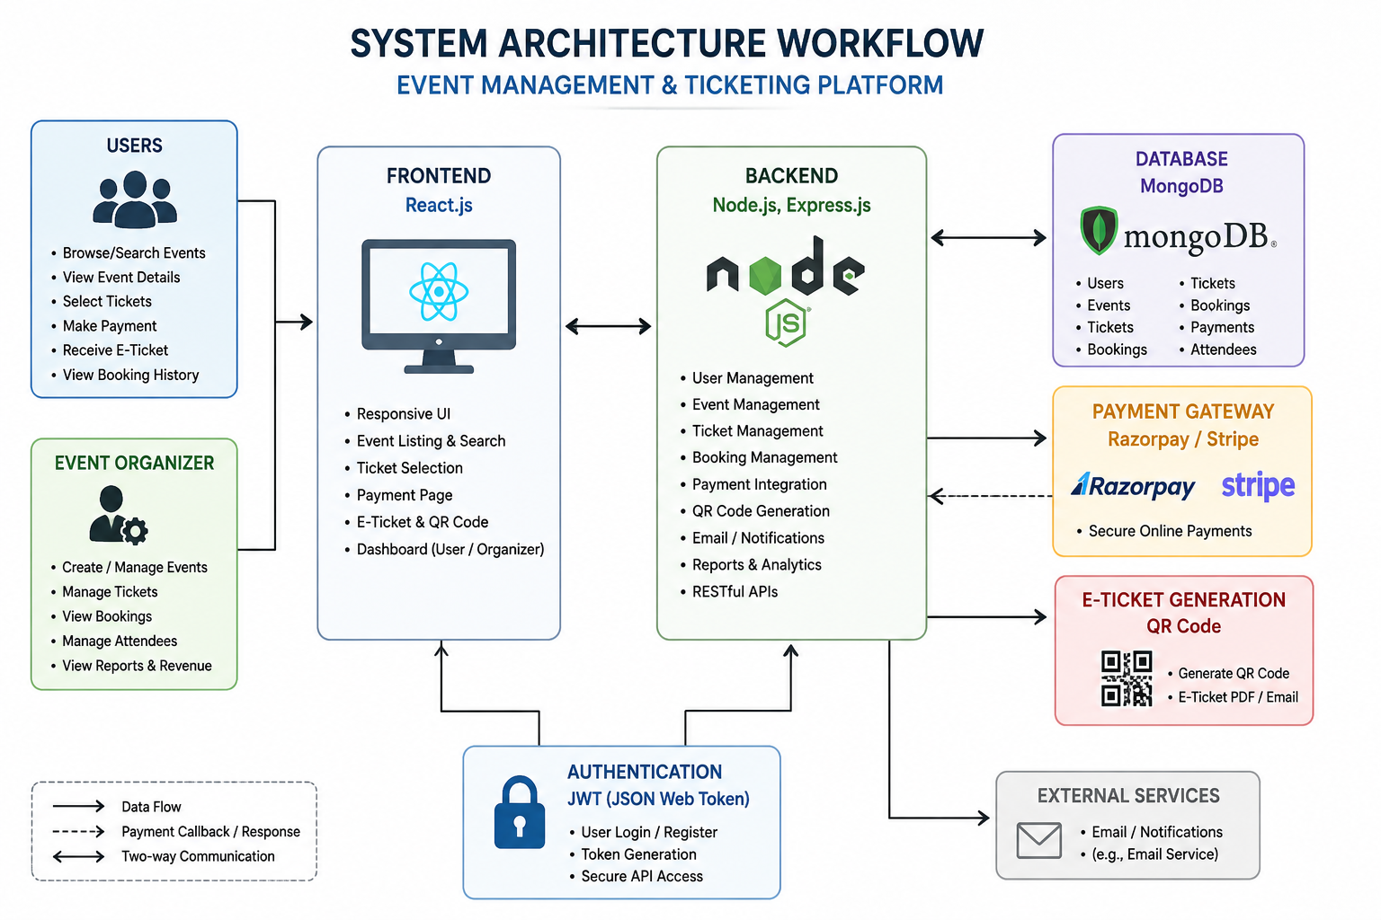

Slide 7
The Event Management & Ticketing Platform provides an efficient and user-friendly solution for modern event organization and ticket booking. By digitizing event creation, ticket booking, payments, e-ticket generation, and attendee management, the system reduces manual work and errors. The use of React.js, Node.js, Express.js, MongoDB, JWT, and online payment gateways helps create a secure, scalable, and reliable platform. Overall, the proposed system improves the experience of both event organizers and users while making event management more organized and efficient.
CONCLUSION

Slide 8
Thank You

